Slide 1
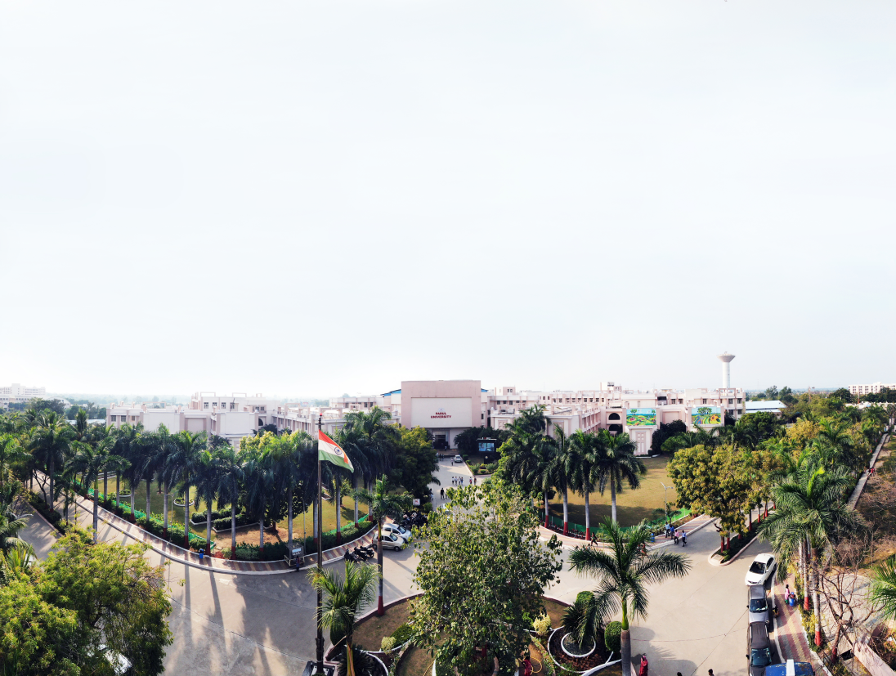


PARULINSTITUTEOF ENGINEERING &TECHNOLOGY
FACULTY OF ENGINEERING & TECHNOLOGY
PARULUNIVERSITY
Subject: WEB DESIGN
Unit 3: CSS Basics & Styling
Computer Science & Engineering

Slide 2
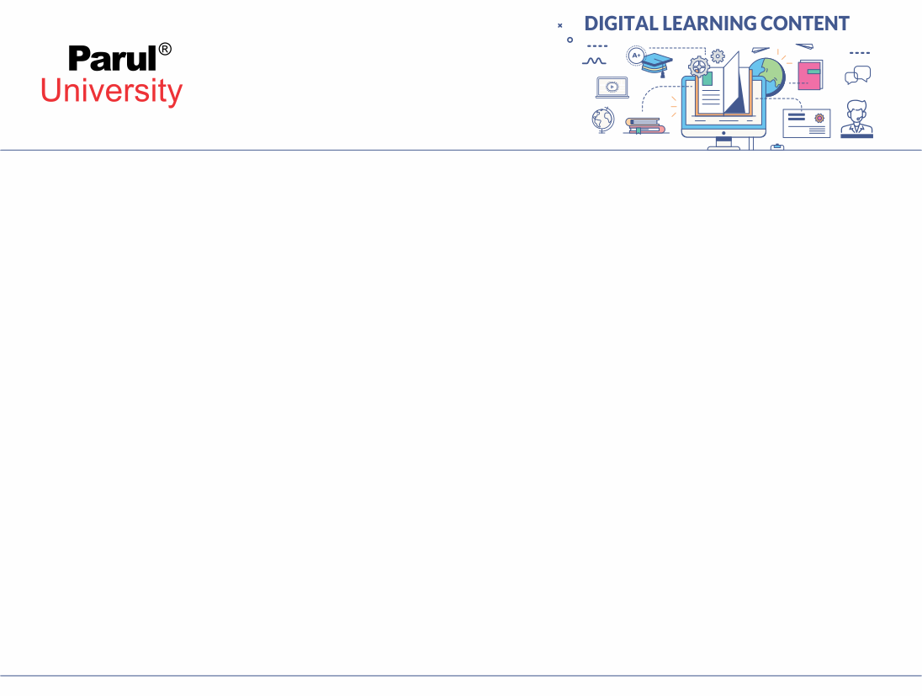


Outline
Selectors and Properties (elements, class, id, hover, active) Box Model & Layout Techniques (content, padding, margin, border, height, width, display, visibility, overflow)3Colors, Fonts, and Backgrounds (font-family, font-style, font-size, font-weight) CSS Flexbox and Grid (justify-content, align-items, flex-wrap, flex-direction, grid-templaterows, grid-template columns, gap ) CSS positions and indexes (fixed, absolute, relative, static, z-index)

Slide 3
Selectors & Properties
What are Selectors?
Selectors decide which HTML element CSS will style
Basic types:
Element selector → p { color: red; }
Class selector → .className { … }
ID selector → #idName { … }

Slide 4
True Positive Rate (TPR)
Pseudo Classes
Special states of elements:
:hover → when mouse is over element
:active → when element is clicked
Example:
button:hover { background: blue; }
button:active { background: green; }

Slide 5
False Positive Rate (FPR)
Box Model & Layout
CSS Box Model
Every element is a box:
Content → text, image
Padding → space inside border
Border → outline around content
Margin → space outside border
Diagram of Box Model

Slide 6
Box Properties
height, width → size
border → thickness, style, color
margin → outer spacing
padding → inner spacing
display → block, inline, flex, grid
overflow → visible, hidden, scroll

Slide 7
Colors, Fonts & Backgrounds
Colors in CSS
Named → color: red;
HEX → color: #ff0000;
RGB → color: rgb(255,0,0);
RGBA → with transparency

Slide 8
Fonts & Text Styling
font-family → Arial, Times, etc.
font-size → px, em, rem
font-style → normal, italic
font-weight → normal, bold
Example:
p { font-family: Arial; font-size: 16px; font-weight: bold; }

Slide 9
Backgrounds
background-color
background-image: url("pic.jpg")
background-repeat, background-size

Slide 10
Flexbox & Grid
CSS Flexbox
Makes flexible layouts
Properties:
display: flex
flex-direction: row/column
justify-content: center/space-between
align-items: center
flex-wrap: wrap
Diagram of flex alignment

Slide 11
CSS Grid
Two-dimensional layout system
Properties:
display: grid
grid-template-rows
grid-template-columns
gap → spacing between items
Example: simple 2x2 grid

Slide 12
Positions & z-index
CSS Positioning
static → default
relative → moves element relative to itself
absolute → positions inside nearest parent
fixed → stays at same spot (like navbar)

Slide 13
z-index
Controls stacking order
Higher value → element appears on top
Example: image overlapping text

Slide 14
Introduction to NLP
Thank You!!!

Slide 15




www.paruluniversity.ac.in

